Slide 1
Prediction Models of Inpatient Admissions
David DiGiuseppe, Caroline Kasman, Mandira Pradhan | CHPW
Yutong Wu, Ning Yang, Zihan Zheng | UW Biostatistics
BIOST 597, Winter 2022

Slide 2






Meet the Team
David DiGiuseppe Caroline Kasman Mandira Pradhan
Yutong Wu Ning Yang. Zihan Zheng
Notes:
zz

Slide 3
Background
Most health care expenditure is usually concentrated on a small proportion of the population
The U.S. is an outlier among peer countries in healthcare spending
The cost of inpatient care is one of the primary drivers of the gap in healthcare expenditure
Essential to develop a valid predictive tool that helps identify individuals who will likely be admitted to the hospital in the near future so that care management team can provide timely support to high-risk members

Slide 4
Objectives
Primary Objective
Build a prediction model for inpatient admission
Secondary Objective
Apply Classification with No Discrimination (CND) technique to correct for racial bias embeded in the data
Notes:
zz

Slide 5
Study Population and Candidate Variables
Population:
Community Health Plan of Washington (CHPW) members from Jan 2018 to Dec 2019 with exclusion criteria.
Candidate Variables
Insurance plan enrollment
Medical claim (medical cost, health resource utilization, facility visits, etc.)
Medical diagnosis (chronic conditions)
Risk level (calculated using internal algorithms by CHPW)
Demographic information (gender, age, race, region of residence, etc.)
Social determinant of health (SDoH) and behavioral health
Notes:
zz
Exclusion criteria: Maternity Members; Severe Cancer; End-stage Renal Disease; Transplantation; Dialysis; Hospice; Death; Newborns (age<1 year)

Slide 6
Modeling

Slide 7
Prediction Models
 | Penalized Logistic Regression (GLM) | Gradient Boosting Trees (GBT) | Bayesian Additive Regression Trees (BART)
Pros: | Easy to implement Fast to compute Straightforward to interpret Mimics previous works done by the sponsor, serves as performance benchmark | 1. Tree-based models that incorporates interactions 2. XGBoost has shown great results in many classification benchmarks. 3. Highly customizable, can be tuned for imbalanced data. | 1. Interactions 2. Provide prediction CI as measure of uncertainty 3. Can be modified for classification 4. Easy to tune
Cons: | Performance not matching state-of-the-art techniques | 1. Less interpretable in nature 2. Tendency of overfitting 3. Lots of tuning parameters | Highly sophisticated algorithm, computation can be slow Less interpretable in nature
R | glmnet | xgboost | bartMachine
Notes:
NY
YW
ZZ

Slide 8
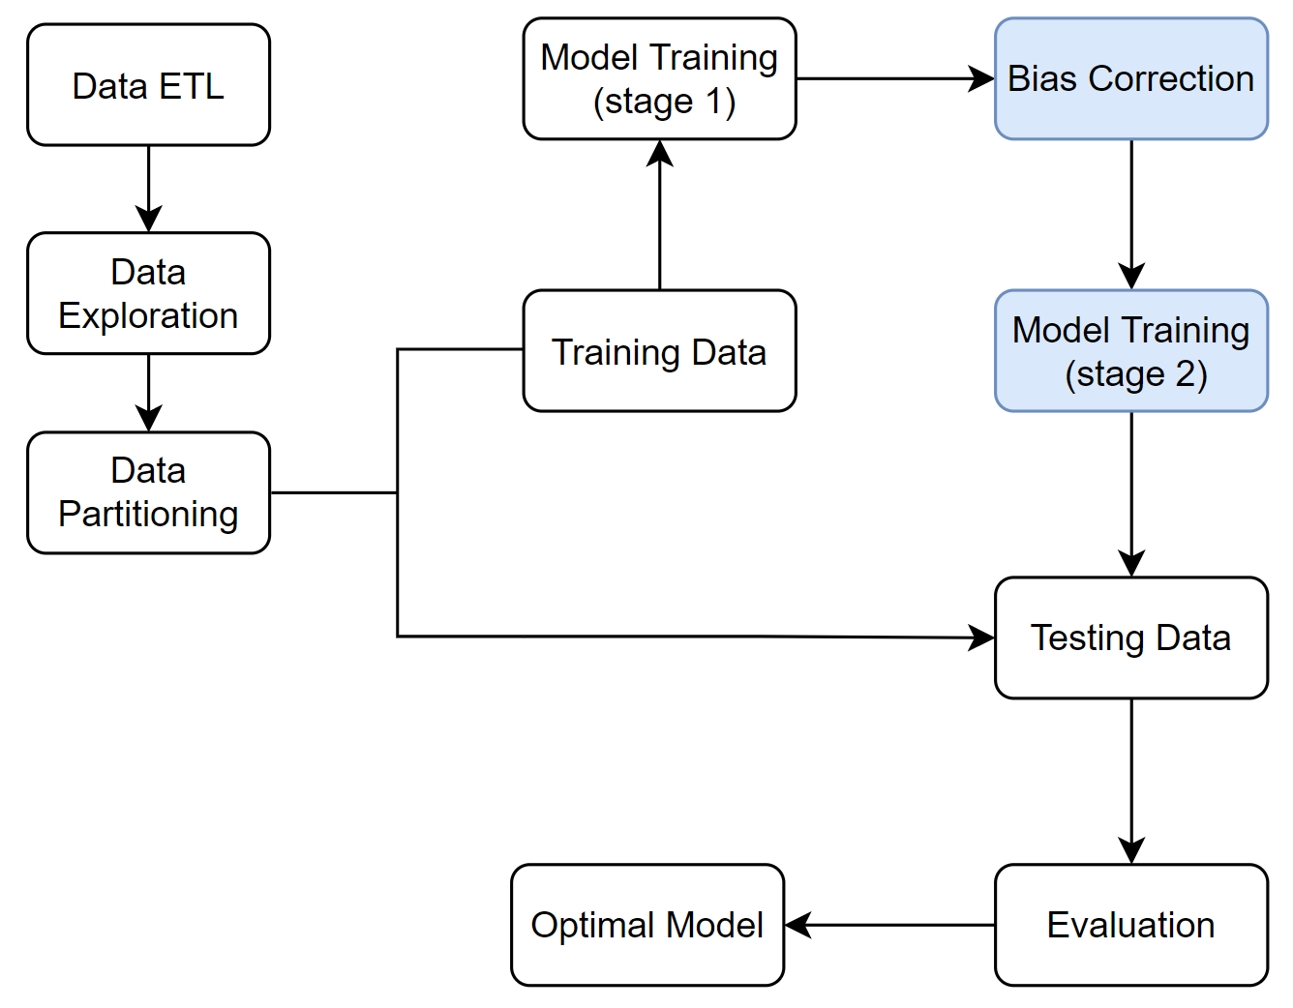
Modeling Procedure
Notes:
Original data will be split into training data and testing data with a ratio of 80:20 using stratified sampling.
Each model will be trained using 10-fold cross validation on the training data in both training stages - before and after the application of CND technique.
Best model from each class will be evaluated using testing data to find the overall best model after the second training stage.
Evaluation metrics: F1-score

Slide 9
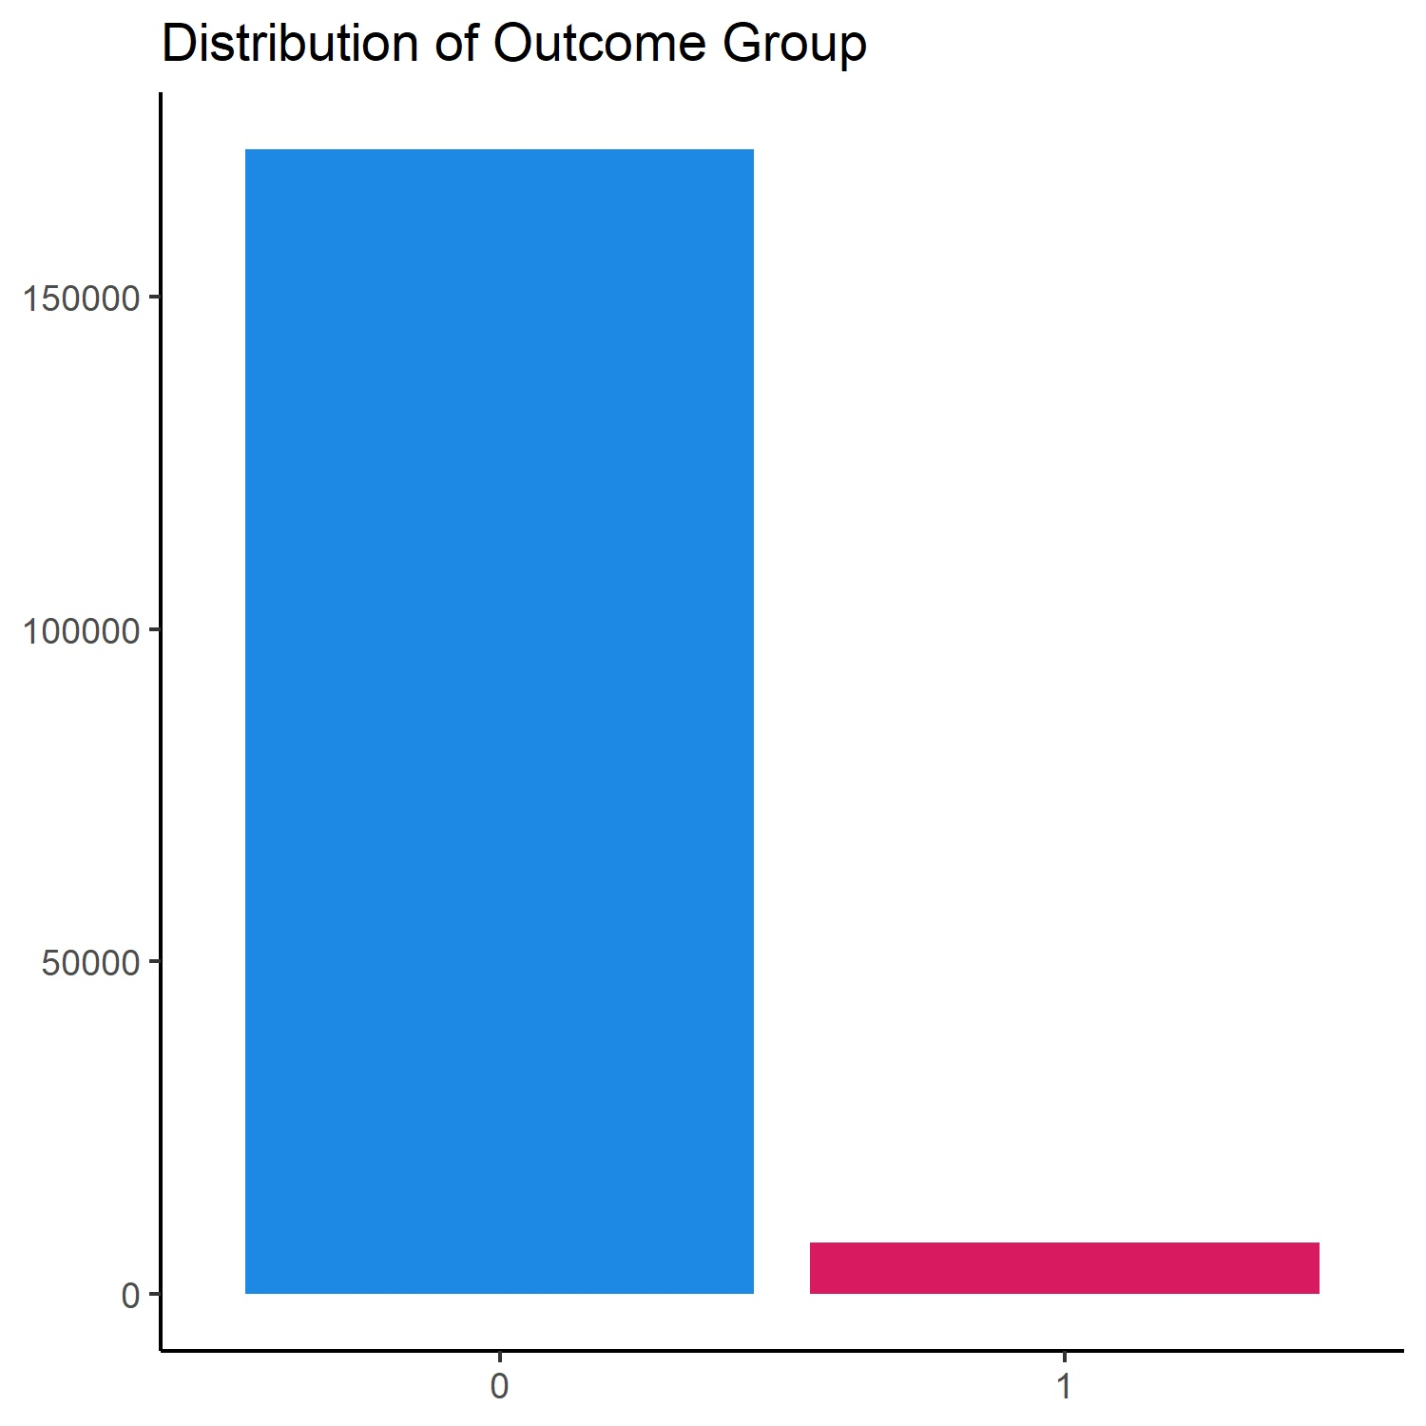
Data Exploration and Pre-processing
Imbalanced outcome distribution - only ~4.3% of all participants are observed with inpatient admission
The majority of predictors are categorical, some of which have many categories (especially chronic conditions), therefore the data matrix is sparse.
Group categories
Normalization of numeric features for GLM.
Notes:
Sparse matrix - for most binary predictors, an overwhelmingly high proportion of data are comprised of zero values
– Solution: There were originally 60 chronic conditions listed as candidate
predictors. Sponsor grouped them into 20 categories to reduce the
sparseness

Slide 10
Primary Analysis and Results

Slide 11
Results: Best Models and Performance
 |  | GLM |  | GBT |  | BART
Sensitivity (Recall) |  | 0.243 |  | 0.343 |  | 0.334
PPV (Precision) |  | 0.238 |  | 0.317 |  | 0.334
F1 |  | 0.240 |  | 0.330 |  | 0.334
True Pos | False Pos | 373 | 1,197 | 495 | 1,066 | 522 | 1,040
False Neg | True Neg | 1,164 | 33,245 | 948 | 33,470 | 1,040 | 33,377
*F1 score = 2*Sensitivity*PPV / (Sensitivity + PPV), range from 0 to 1

Slide 12
Secondary Analysis and Results

Slide 13
Classification with No Discrimination (CND)
If training data is biased towards certain groups, the learned model will also show discriminatory behavior, leading to biased prediction outcomes.
Impartial classification results are usually desired or even required
CND makes the least intrusive modifications to the biased dataset, aiming to reduce prejudicial behavior for future classification with minimal lose of predictive accuracy
Notes:
If the training data is biased towards certain groups, then the model trained on this biased data will produce biased predictions.
In our use case we require our predictions to be unbiased across all races.
CND is the technique that makes the least intrusive modifications to the training data to fix the bias in prediction.

Slide 14
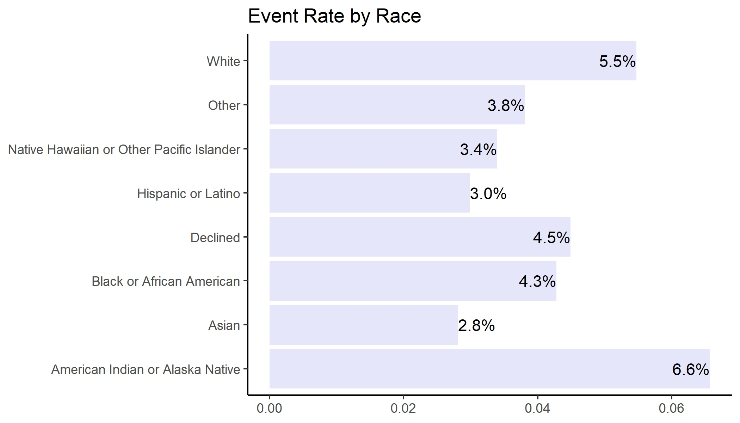
Bias Exploration
Chi-squared test p < 0.0001
Notes:
Here’s a barplot show the proportion of people who are admitted to inpatient facilities in 2019 in different racial groups.
We can clearly see there a difference across racial groups.
More formally, a Chi-squared test performed to test the equality of the proportion of inpatient admissions in each race, and the p-value is less than 1e-10 -> bias in the data

Slide 15
CND Data Massaging in Training Data
 | Number of Obs
American Indian / Alaska Native | 1,474
Asian | 9,812
Black / African American | 10,914
Declined | 3,628
Hispanic or Latino | 45,945
Native Hawaiian / Pacific Islander | 3,647
Other | 2,239
White | 66,261
Total | 143,920
First column is total number of observations in each race
Notes:
This table will grow as we go through the process
Here in the first column are the numbers of observations in each race in the training data

Slide 16
CND Data Massaging in Training Data
 | Number of Obs | Proportion in Population (%)
American Indian / Alaska Native | 1,474 | 1
Asian | 9,812 | 6.8
Black / African American | 10,914 | 7.6
Declined | 3,628 | 2.5
Hispanic or Latino | 45,945 | 31.9
Native Hawaiian / Pacific Islander | 3,647 | 2.5
Other | 2,239 | 1.6
White | 66,261 | 46.1
Total | 143,920 | 100
Second column is the proportion of each race in training population
Notes:
Divided by the total number, we get the proportion in percentage of each race in the whole population

Slide 17
CND Data Massaging in Training Data
 | Number of Obs | Proportion in Population (%) | Actual Admissions
American Indian / Alaska Native | 1,474 | 1 | 90
Asian | 9,812 | 6.8 | 283
Black / African American | 10,914 | 7.6 | 478
Declined | 3,628 | 2.5 | 165
Hispanic or Latino | 45,945 | 31.9 | 1342
Native Hawaiian / Pacific Islander | 3,647 | 2.5 | 129
Other | 2,239 | 1.6 | 78
White | 66,261 | 46.1 | 3640
Total | 143,920 | 100 | 6205
Third column is actual number of inpatient admissions in each race
Notes:
The third column gives the actual number of inpatient admissions in each race

Slide 18
CND Data Massaging in Training Data
 | Number of Obs | Proportion in Population (%) | Actual Admissions | Expected Admissions
American Indian / Alaska Native | 1,474 | 1 | 90 | 64
Asian | 9,812 | 6.8 | 283 | 423
Black / African American | 10,914 | 7.6 | 478 | 471
Declined | 3,628 | 2.5 | 165 | 156
Hispanic or Latino | 45,945 | 31.9 | 1342 | 1981
Native Hawaiian / Pacific Islander | 3,647 | 2.5 | 129 | 157
Other | 2,239 | 1.6 | 78 | 97
White | 66,261 | 46.1 | 3640 | 2857
Total | 143,920 | 100 | 6205 | 6206
Fourth column is expected inpatient admissions calculated using proportions and total number of admissions
Notes:
Using the proportion column, multiply each proportion by the total number of actual admissions, will give us the expected number of admissions if all races have same incidence rate, which is what we want to see in the prediction

Slide 19
CND Data Massaging in Training Data
 | Number of Obs | Proportion in Population (%) | Actual Admissions | Expected Admissions | Difference
American Indian / Alaska Native | 1,474 | 1 | 90 | 64 | 26
Asian | 9,812 | 6.8 | 283 | 423 | -140
Black / African American | 10,914 | 7.6 | 478 | 471 | 7
Declined | 3,628 | 2.5 | 165 | 156 | 9
Hispanic or Latino | 45,945 | 31.9 | 1342 | 1981 | -639
Native Hawaiian / Pacific Islander | 3,647 | 2.5 | 129 | 157 | -28
Other | 2,239 | 1.6 | 78 | 97 | -19
White | 66,261 | 46.1 | 3640 | 2857 | 783
Total | 143,920 | 100 | 6205 | 6206 | -1
Fifth column is difference of expected and actual admissions
Notes:
Finally, we take the difference of the expected and the actual number of admissions.
This difference is the number of modifications needed in each race so that the modified number matches the expected number.

Slide 20
CND Data Massaging in Training Data
 | Number of Obs | Proportion in Population (%) | Actual Admissions | Expected Admissions | Difference
American Indian / Alaska Native | 1,474 | 1 | 90 | 64 | 26
Asian | 9,812 | 6.8 | 283 | 423 | -140
Black / African American | 10,914 | 7.6 | 478 | 471 | 7
Declined | 3,628 | 2.5 | 165 | 156 | 9
Hispanic or Latino | 45,945 | 31.9 | 1342 | 1981 | -639
Native Hawaiian / Pacific Islander | 3,647 | 2.5 | 129 | 157 | -28
Other | 2,239 | 1.6 | 78 | 97 | -19
White | 66,261 | 46.1 | 3640 | 2857 | 783
Total | 143,920 | 100 | 6205 | 6206 | -1
Demotion / Promotion
Notes:
If diff is negative, then the race is in the Promotion group, otherwise it’s in the Demotion group
Using the predicted probability in training stage 1, we rank within each race
We identified 26 observations in American Indian / Alaska Native group who have the outcome of inpatient admission and are ranked the lowest according to the predicted probability in training stage 1; we demote them by switch their labels from 1 to 0
Similarly, we find 140 observations in Asian group who don’t have the outcome of inpatient admission and are ranked highest according to the prediction model; we promote them by switch their labels from 0 to 1
We do this to all racial groups. After we are done, we modified the training data in the least intrusive way to make each race have the same incidence rate

Slide 21
Bias Correction Results in Testing Data
 | Number of Observations | Proportion in Population | Actual Admissions | Expected Admissions
American Indian / Alaska Native | 398 | 1.1 | 33 | 17
Asian | 2,417 | 6.7 | 61 | 105
Black / African American | 2,825 | 7.8 | 110 | 123
Declined | 890 | 2.5 | 38 | 39
Hispanic or Latino | 11,361 | 31.6 | 369 | 493
Native Hawaiian / Pacific Islander | 889 | 2.5 | 25 | 39
Other | 572 | 1.6 | 29 | 25
White | 16,627 | 46.2 | 897 | 722
Total | 35,979 | 100 | 1,562 | 1,563
Notes:
Now we evaluate the effect of CND on testing prediction
The first columns are calculated the same way as in the last table, only in testing data

Slide 22
Bias Correction Results in Testing Data
 | Expected Admissions | Predicted Before CND | Difference Before CND | Predicted After CND | Difference After CND
American Indian / Alaska Native | 17 | 31 | 14 | 21 | 4
Asian | 105 | 42 | -63 | 85 | -20
Black / African American | 123 | 114 | -9 | 114 | -9
Declined | 39 | 36 | -3 | 38 | -2
Hispanic or Latino | 493 | 293 | -200 | 492 | 0
Native Hawaiian / Pacific Islander | 39 | 30 | -9 | 36 | -3
Other | 25 | 27 | 2 | 34 | 9
White | 722 | 989 | 267 | 742 | 20
Total | 1,563 | 1,562 |  | 1562
Chi-squared before CND gives p < 0.0001,
Chi-squared after CND gives p = 0.2
Notes:
The fifth columns is the number of predicted inpatient admissions before CND
Taking the difference between the predicted number and the expected number of admissions, we get the difference column, which is essentially the bias in prediction result.

Slide 23
Performance Comparison before and after CND
 |  |  | GLM |  | GBT |  | BART
Before CND | F1 |  | 0.242 |  | 0.334 |  | 0.342
 | True Pos | False Pos | 367 | 1,104 | 499 | 1,047 | 534 | 1,028
 | False Neg | True Neg | 1,170 | 33,338 | 944 | 33,489 | 1,028 | 33,389
After CND | F1 |  | 0.240 |  | 0.330 |  | 0.334
 | True Pos | False Pos | 373 | 1,197 | 495 | 1,066 | 522 | 1,040
 | False Neg | True Neg | 1,164 | 33,245 | 948 | 33,470 | 1,040 | 33,377
Notes:
This table shows the comparison in performance before and after applying CND

Slide 24
Discussion

Slide 25
Model Performance and Bias Correction
Model Performance
Overall model performance was not ideal
Class imbalance in the outcome had a huge impact
Subsampling techniques (up, down, ROSE, SMOTE) did not carry out successfully due to limited computational resources
Bias Correction
Successfully corrected racial bias in prediction results
Minimal loss of prediction power
Notes:
YW

Slide 26
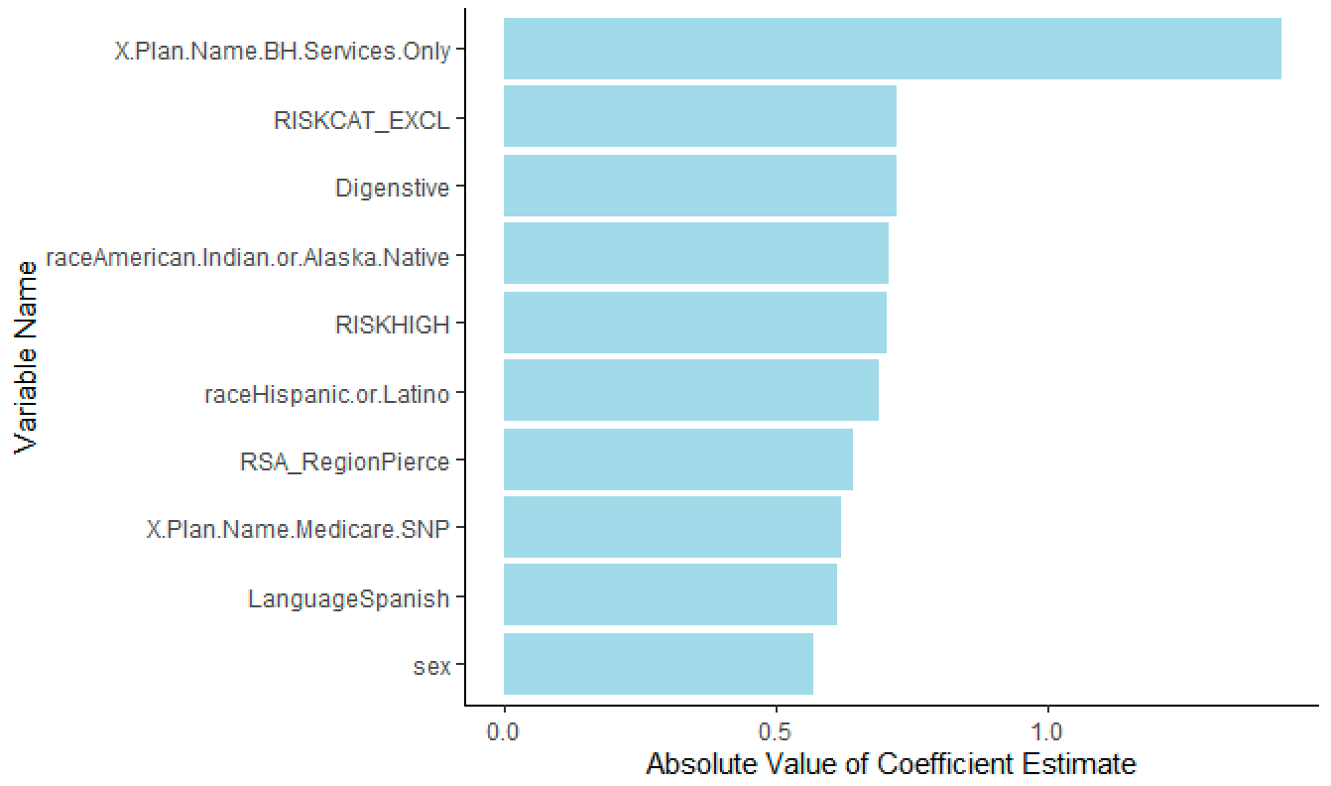
Feature Importance: GLM
Importance measured by magnitude of coefficient
Notes:
One feature in GLM stands out is insurance plan of BH Service Only

Slide 27
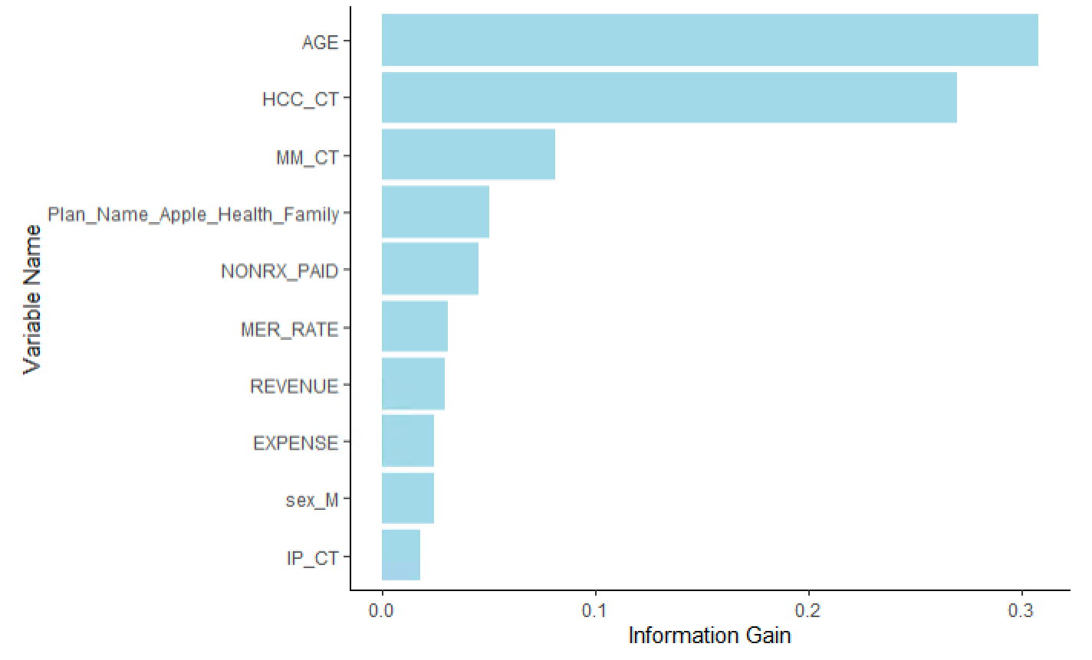
Feature Importance: GBT
Importance measured by information gain
Notes:
Two features that are more important than others are:
Age
Number of chronic conditions

Slide 28
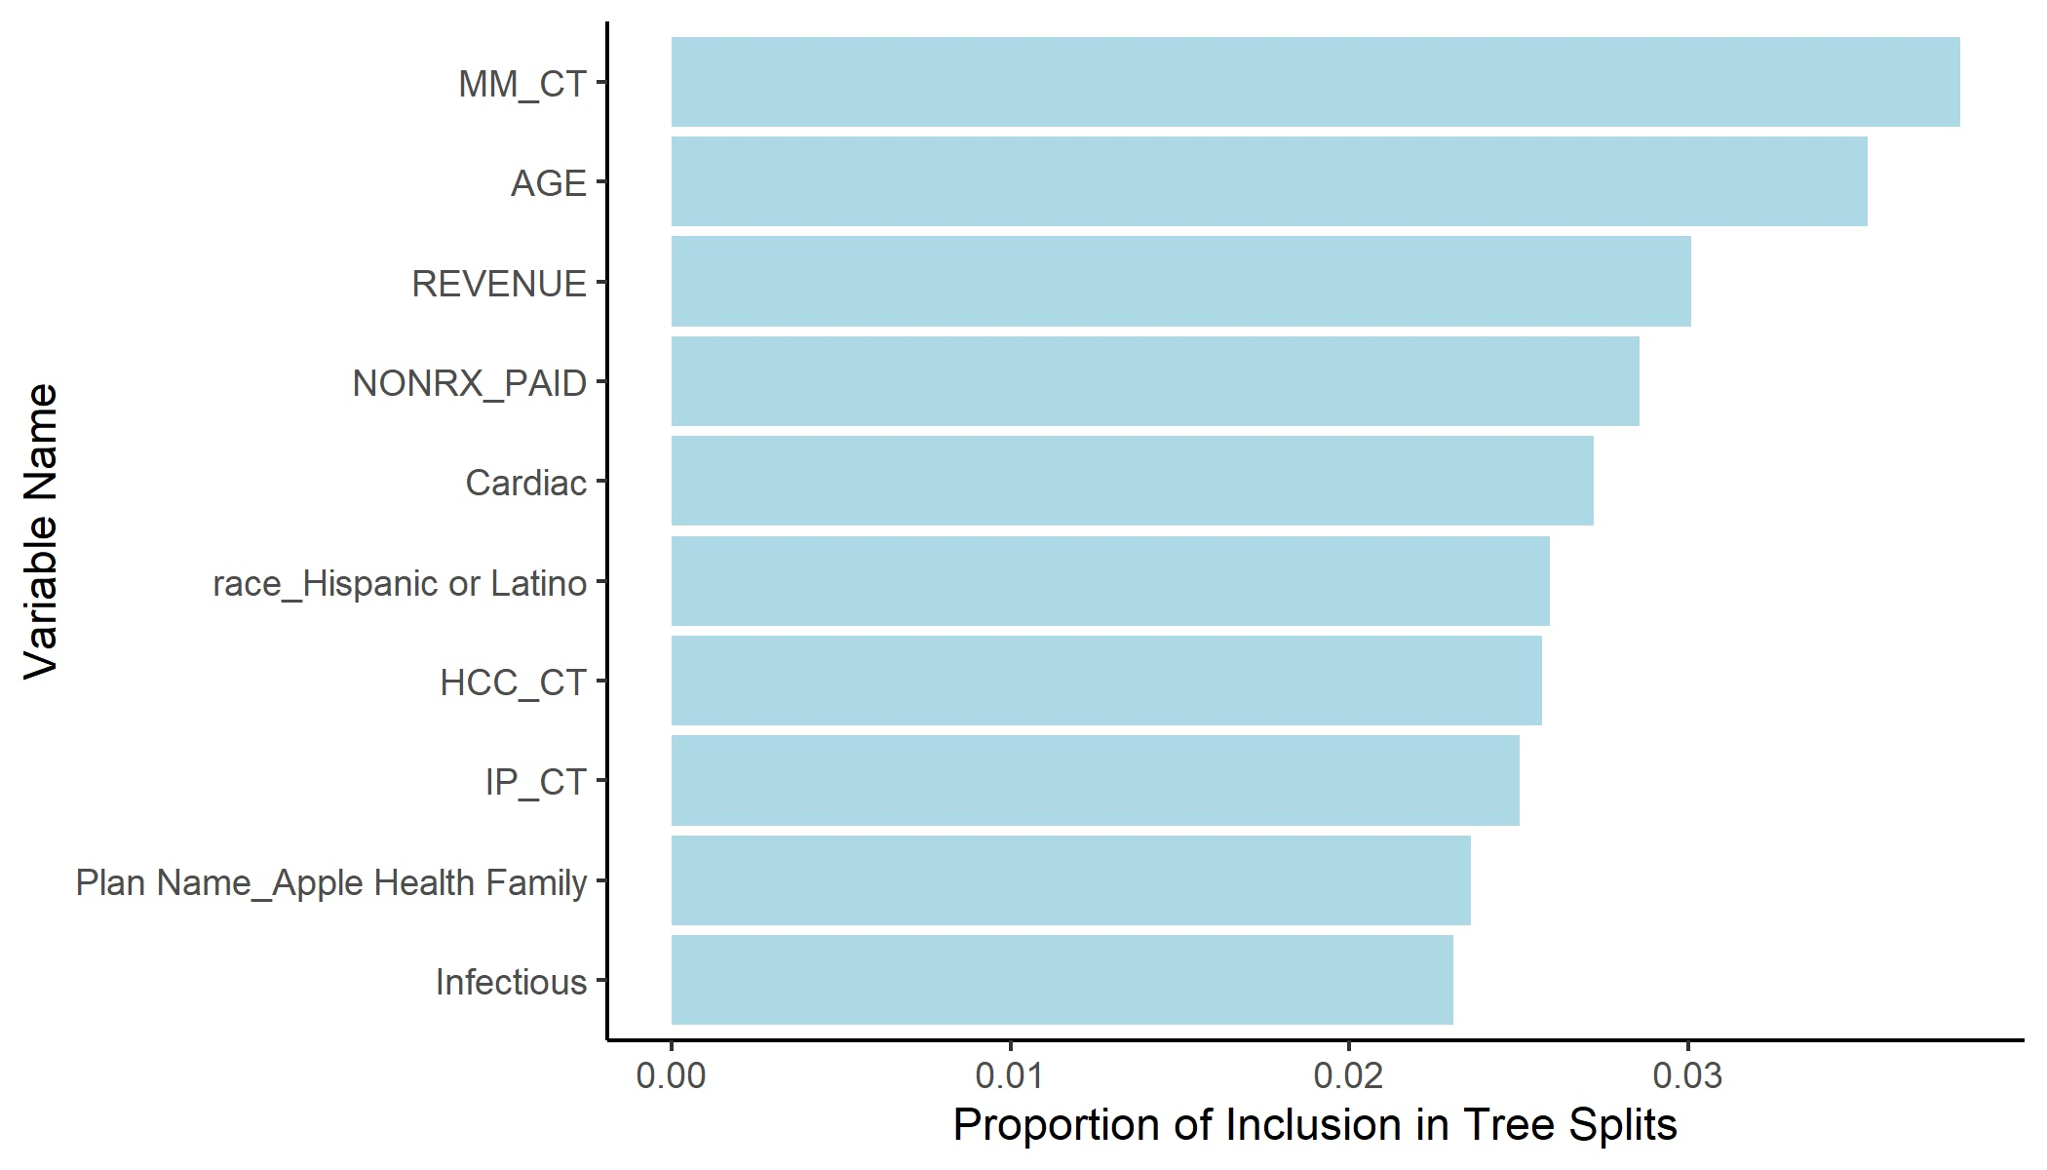
Feature Importance: BART
Importance measured by proportion of inclusion in splits
Notes:
Nothing stands out, but overall seems to agree with GBT

Slide 29
Feature Importance
Results are very similar in GBT and BART; top important features are:
Age
Number of chronic conditions
Membership months
Medical expenses
Revenue
Insurance plan (Apple Health)
Number of inpatient admissions in previous year
GLM disagree with tree-based models:
Insurance plan (BH Service, Medicare)
Hispanic / Native American and Native Alaska race
High / Catastrophic risk level

Slide 30
Project Impact
Improved a lot compared to sponsor’s prior work (subset of population on different time frame).
Identified potential risk factors for inpatient admission.
Established confidence in the CND technique.
Notes:
YW

Slide 31
Future Directions
Split the study population and build group-specific prediction models
Collect data on additional factors that may contribute to outcome prediction
Implement more advanced techniques to handle imbalance data
Try different classification algorithms
Notes:
YW

Slide 32
SPECIAL THANKS TO:
Prof. Patrick Heagerty
Prof. Lloyd Mancl
Mandira Pradhan
Caroline Kasman
David DiGiuseppe

Slide 33

Thank you!

